Slide 1
Inhibition of Return (IOR)
Building the Posner cueing task in PsychoPy

Slide 2
The experiment needs…
A fixation cross/spot (controlling eye gaze will be important in this study)
We want the fixation to flash a different colour. To do this briefly draw another one ‘in front’ of the fixation
A target (another cross?) that could be on left or right
A method for subjects to respond (keyboard)
A pair of rectangles (left and right, to help locate the target in space)
A cue
draw a yellow square, bigger than the locating rectangles and ‘behind them’
In PsychoPy, to have something draw ‘behind’ the others, it needs to be higher in the list of Components

Slide 3
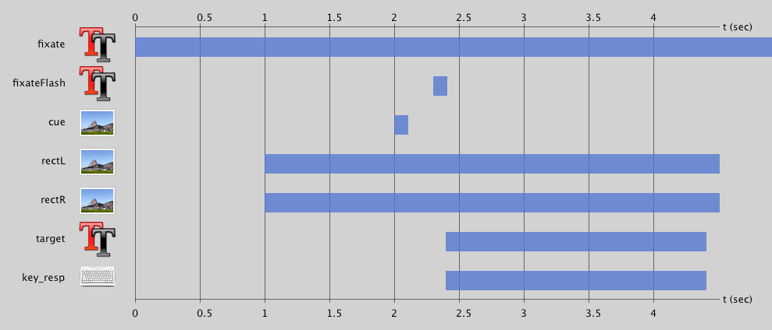
So we need (roughly)
Flash in front of fixation
Cue behind rectangles
Target in front of rectangles

Slide 4
Spatial layout
Rectangles
+
X
Fixation
Target (left or right)
Cue (left or right)

Slide 5
Conditions
CueX | TargetX | Validity | SOA | SOA_ms | corrAns
-10 | -10 | Valid | 3 | 50 | space
10 | 10 | Valid | 3 | 50 | space
-10 | 10 | Invalid | 3 | 50 | space
10 | -10 | Invalid | 3 | 50 | space
-10 | 400 | No_target | 3 | 50
10 | 400 | No_target | 3 | 50
-10 | 400 | No_target | 3 | 50
10 | 400 | No_target | 3 | 50
-10 | -10 | Valid | 6 | 100 | space
10 | 10 | Valid | 6 | 100 | space
-10 | 10 | Invalid | 6 | 100 | space
10 | -10 | Invalid | 6 | 100 | space
-10 | 400 | No_target | 6 | 100
10 | 400 | No_target | 6 | 100
-10 | 400 | No_target | 6 | 100
10 | 400 | No_target | 6 | 100
-10 | -10 | Valid | 18 | 150 | space
10 | 10 | Valid | 18 | 150 | space
-10 | 10 | Invalid | 18 | 150 | space
10 | -10 | Invalid | 18 | 150 | space
-10 | 400 | No_target | 18 | 150
10 | 400 | No_target | 18 | 150
-10 | 400 | No_target | 18 | 150
10 | 400 | No_target | 18 | 150
Create Excel file like this
NB:
Cue/Target X positions:
-10 = 10cm left of centre
10 = 10cm right of centre
400 = off screen (so invisible)
SOA is given in number of frames (1/60s) for precision
Validity and SOA_ms are just for our records
corrAns is space bar if target present and nothing (no response) if not present

Slide 6
Stimulus timing and layout
For this study, the time differences are going to be very small so precise timing is going to be very important
We should use number of frames to control onset/offset with greatest precision
3 frames = 3 x 1/60s = 0.05s = 50ms

Slide 7
Component Details
Rectangles and cue:
To create a grey square add a Patch Component with;
Image = None
Colour (advanced properties) right-click and select a colour (e.g. light grey for rectangle, yellow for cue)

Slide 8
Component Details Summary
name | type | start | Start expected | finish | Finish expected | pos | size
fixate | Text (+)
fixFlash | Text (+)
Cue | Patch (image=None)
rectL | Patch (image=None)
rectR | Patch (image=None)
target | Text (X)
key_resp | keyboard

